Slide 1
Brief introduction into complex properties of HVAC-R products within the CAE-FM sector
Ing. Richard Pinka
Dept of applied informatics
/ Faculty of Civil Engineering
CTU Prague

Slide 2
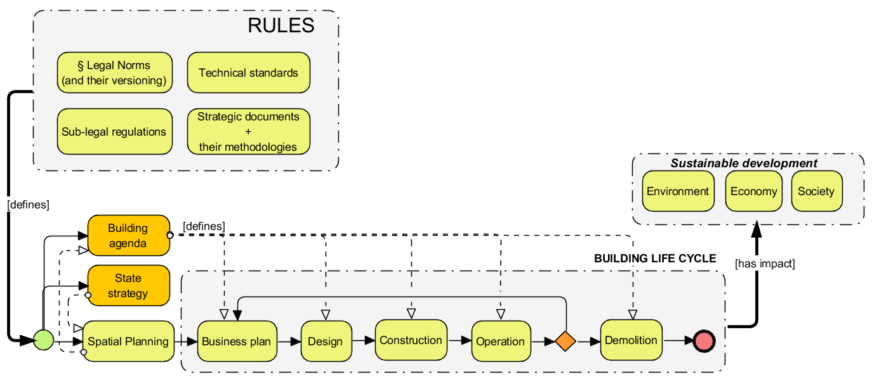
LIFE CYCLE OF A BUILDING AND WHERE ARE WE ?

Slide 3
Workflow is simple
Designer finds out how much cooling and heating energy and ventilated air building needs
Designer define building systems (topology, capacities… )
Designer looks for products
And looks for product parameters
Maybe he estimates energy consumptions
Aligns products and parameters to particular system design

Slide 4
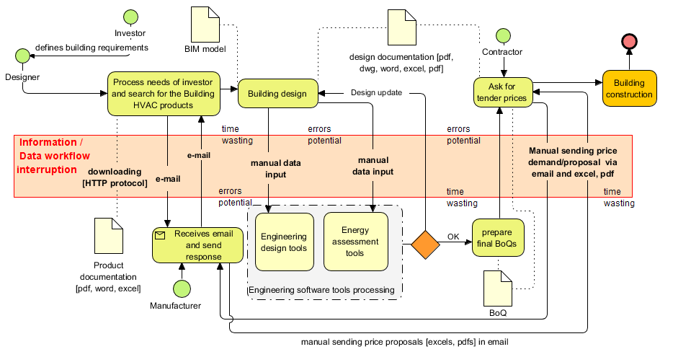
WHY DO WE CARE ?
BECAUSE WE NEED TO DESCRIBE THINGS BETTER TO COMPUTERS
(WE ARE NOT DOING THIS TODAY)
Workflow is also
Hard …

Slide 5
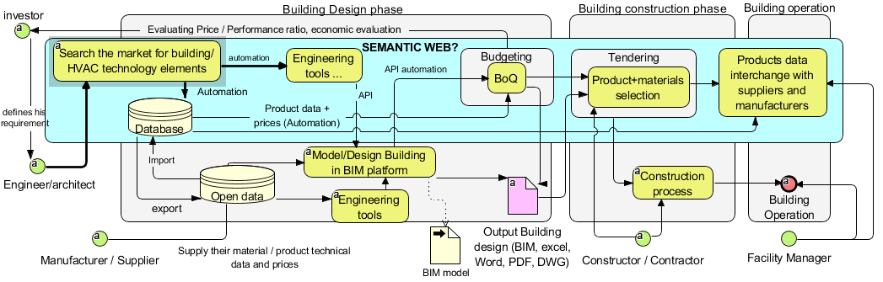
THIS COULD LOOK BETTER, YES ?
BUT WE NEED TO KNOW HOW TO EXPLAIN THINGS (PROPERTIES) TO COMPUTERS..

Slide 6
There are properties, which are required to define for BoQ´s and tendering
There are properties for Design (of the maximum-worst characteristics)
There are properties for LCC / energy consumption / economic assessment
There are differences between them

Slide 7
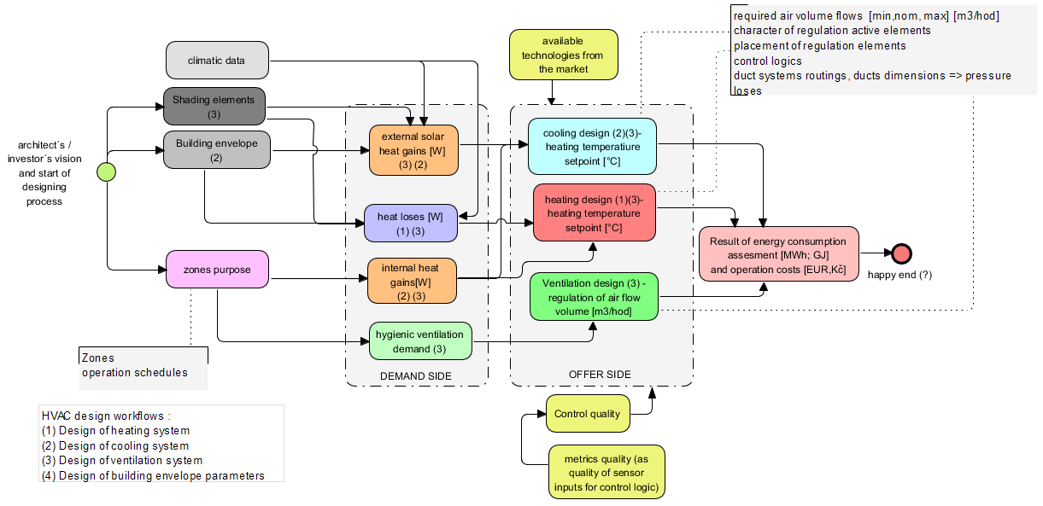
HVAC Designer´s worklow
from the life-cycle assessment&design approach

Slide 8
HVAC product properties for DESIGN
Why we do need to know particular product properties ?
Purpose of HVAC ?
To bring or remove thermal energy into/from building.
(we call it heating and cooling energy acc. Its purpose)
To bring fresh air into building (hygienic ventilation)
HOW ?
To move heat-exchange medium by ducts and pipes
Mediums:
air
water
mixture of water and ..
refrigerants
Purposes:
To ventilate
To heat
To cool
FLUIDS !
air
water
Water mixtures
refrigerants
We need to change of their temperature, and move it from place A to B , and back, from B to A ..

Slide 9
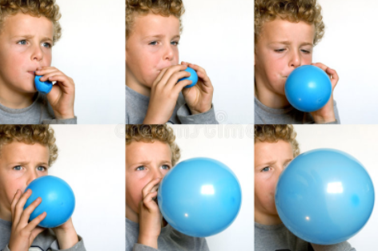


PROPERTY MODELLING
Example: pressure
Whose property is it ?
- baloon´s property ?
Boy´s property ?
Property of Boy´s wish to blow a baloon ?
Baloon´s and boys property ?
Fig:3
Many time snapshots of the World (or many worlds)
Conditional change of property of something…
If (boy knows how to blow baloon, AND he wants to blow baloon):
then: pressure inside baloon wil rise from moment to next moment
else: probably nothing happens (no pressure in ballon will change)
Fig:1
World A: only atmospheric pressure exists
Fig:2
World B: there exist pressure higher than atm. Why? How ?

Slide 10
We need to be able to define
Lets differenciate some properties groups
WHY ?
Because of building Operation parameters …
1/ „static properties and individuals“ which are still existing no matter world
- rigid properties of endurants in the terminology of Unified-Foundational-Ontology
2/ some kind of dynamic properties and individuals which may exist in certain world and time
- non-rigid properties of endurants in the terminology of Unified-Foundational-Ontology

Slide 11
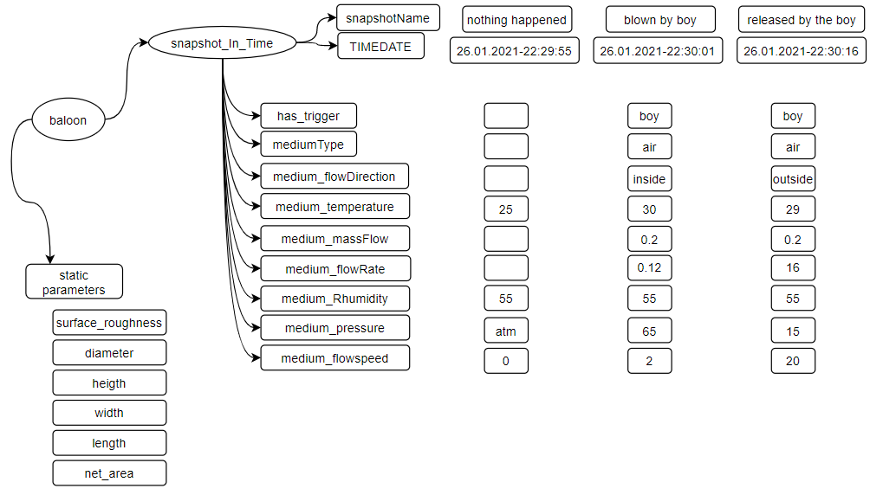
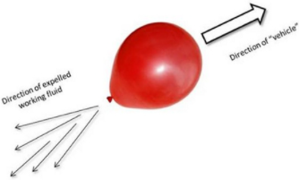
Remember the baloon ?

Slide 12
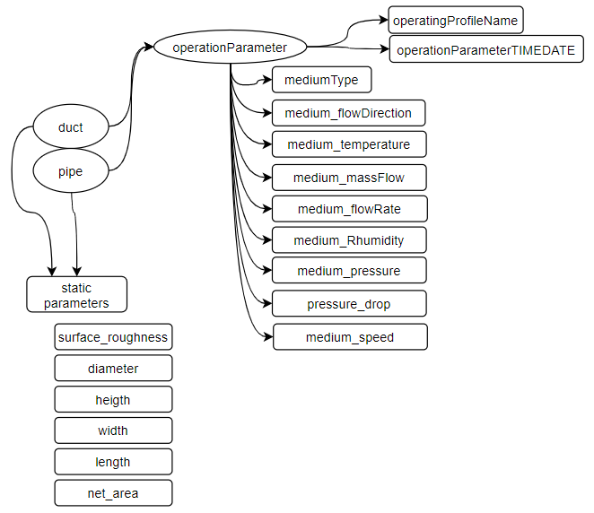
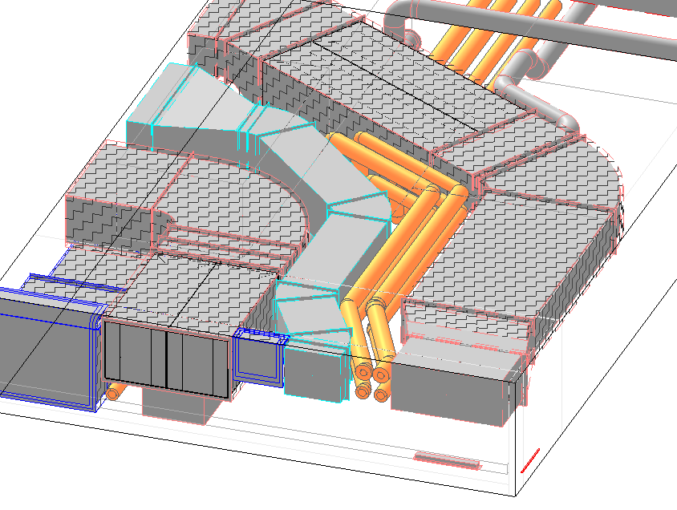
Ducts/pipes variable (non-rigid) properties

Slide 13
We need to be able to model:
Complex properties and properties connections in the meaning of
tabular data, and analytical descriptions of curves and 3Dshapes
Processes, triggers and moments
Well , we need to be prepared for thousdands instances of properties..
MIRIADS instances of properties !!!

Slide 14

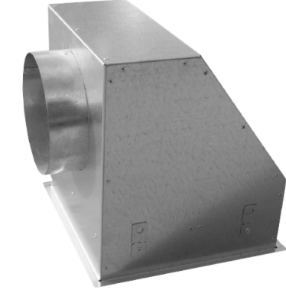
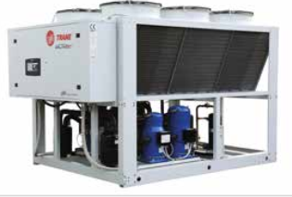
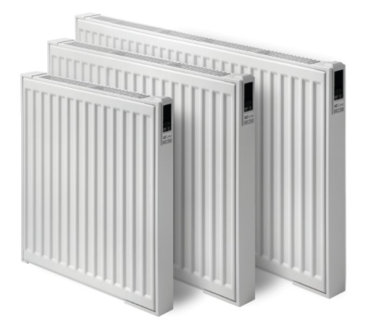
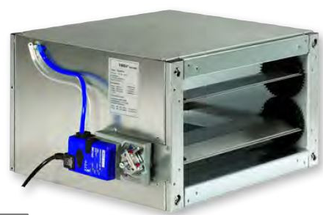
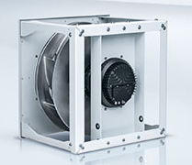
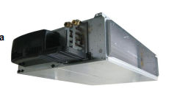
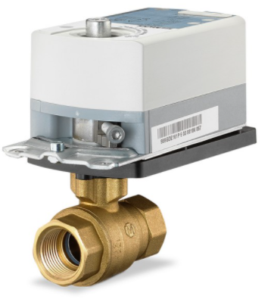
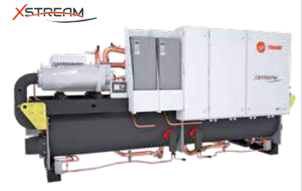
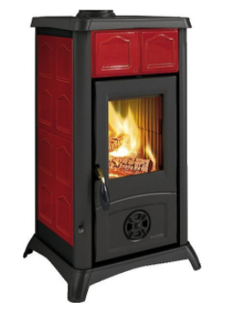
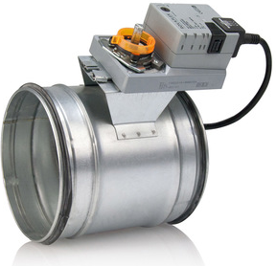
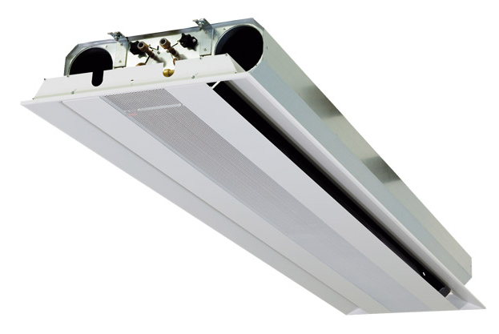
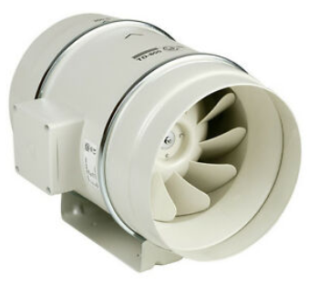
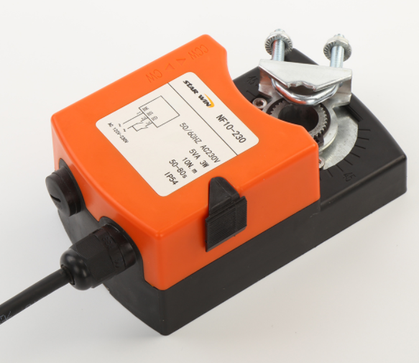
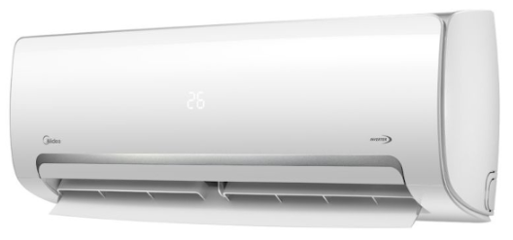
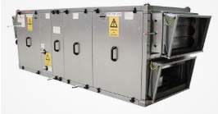
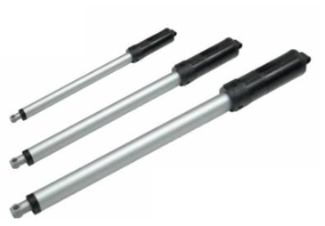
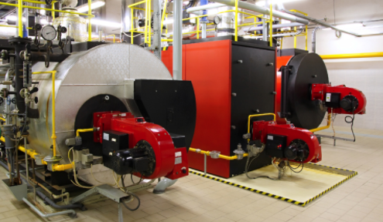
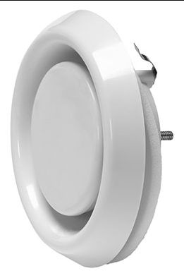
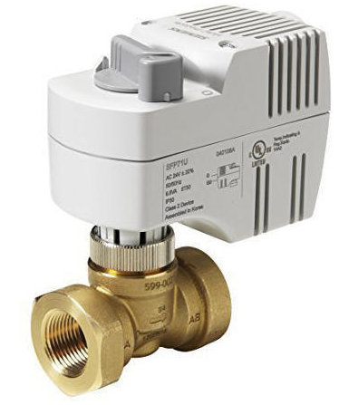
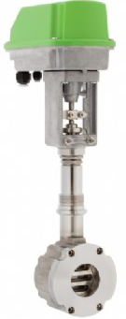
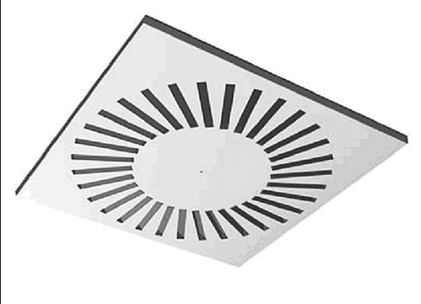
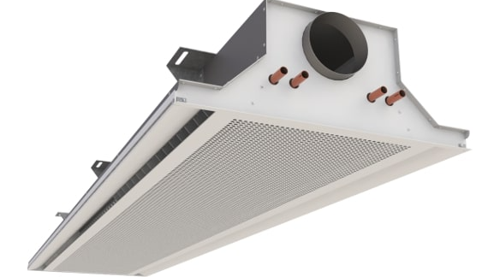
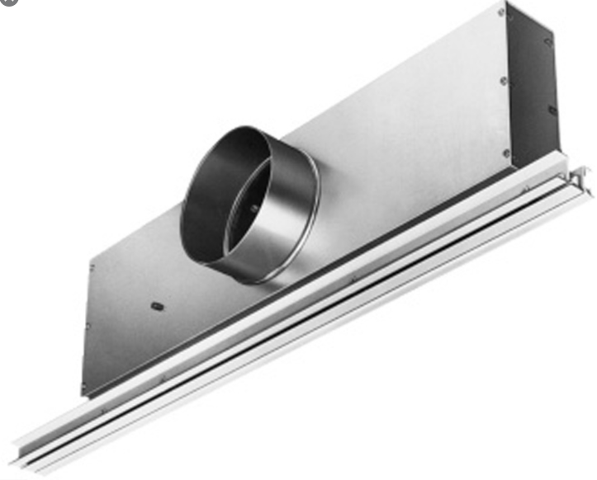
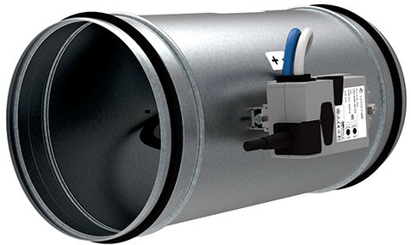
Basic product categories :
PRODUCTS
End Appliances
Heat / cool energy sources
Action elements and Control elements
… and their characteristics
… and their characteristics

Slide 15
Last but not least - operation (control) logics Building automation systems - BAS
CONTROL LOGIC
Is there only one speed of fluid all the time ? NO .
Is there only one set of temperatures all the time ? NO .
Is it exact and wise to estimate energy consuptions with trivial properties
such COP / EER as one number? NO .
such SCOP / ESEER as one number ? Well, not really : )
Constant flow systems and operation Variable flow systems and operation
- same volumeflows during min/max -different volumeflows during min/max
Constant pressure operation Variable pressure operation
- same water-pressure all the time -water-pressure changes during min/max
Impact e.g. On procedures on EN 15459-1
Economic evaluation procedure for energy systems in buildings - Part 1: Calculation procedures, Module M1-14

Slide 16
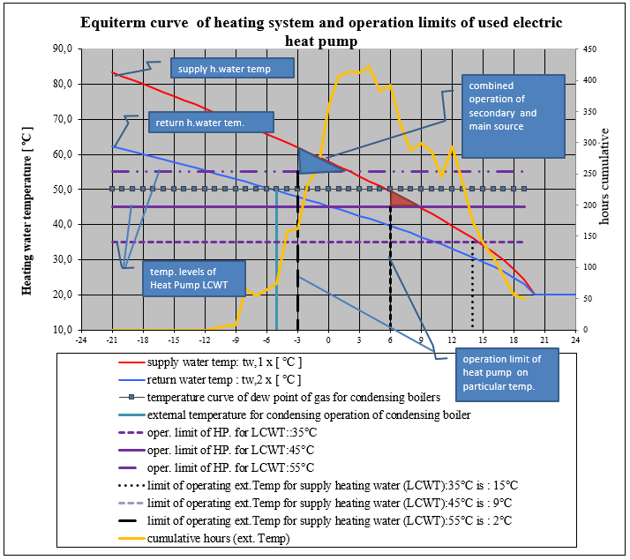
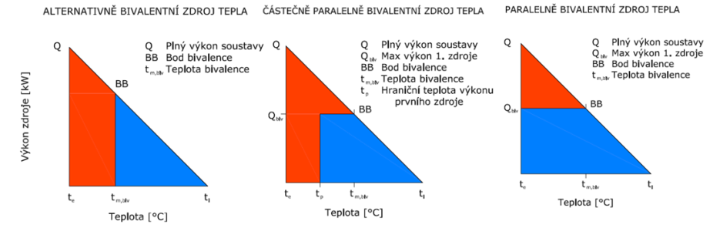
Better look on operation logics in BAS
-> many parameters changes over year-time, day-time …
CONTROL LOGIC
Primary heat source –blue
Secondary heat source - red

Slide 17
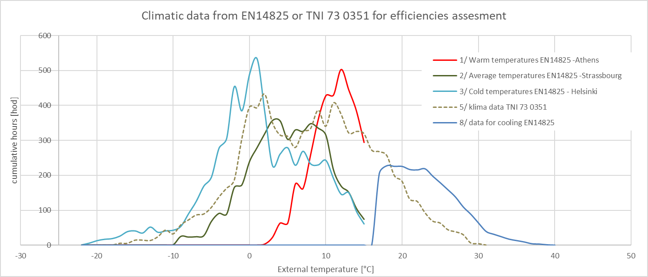
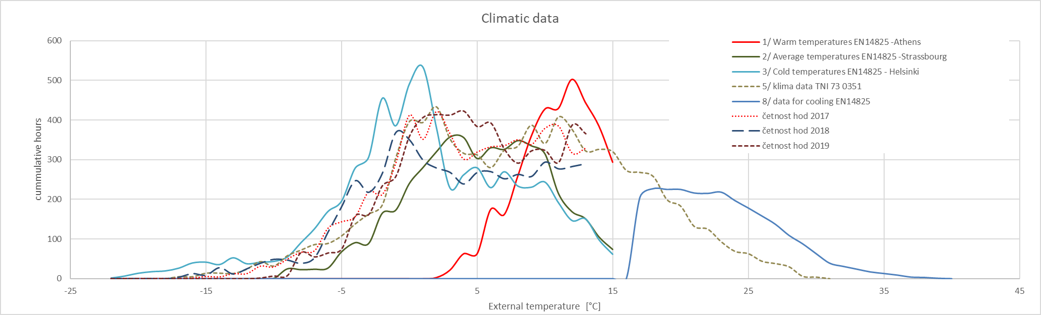
CLIMATIC DATA – INPUT PARAMETER

Slide 18
MAIN IDEAS OF THIS PRESENTATION
TABULAR DATA, CURVES AND 3D SHAPES as PROPERTIES in daily practice…
Properties description needs mathematical background for their description
- if some ontologies for mathematic formulas exists, it needs to be implemented
It is essential to sort out presenting and processing of the :
: tabular data of product props.. (numerical representation of properties)
: analytical representations (if exists) of properties

Slide 19
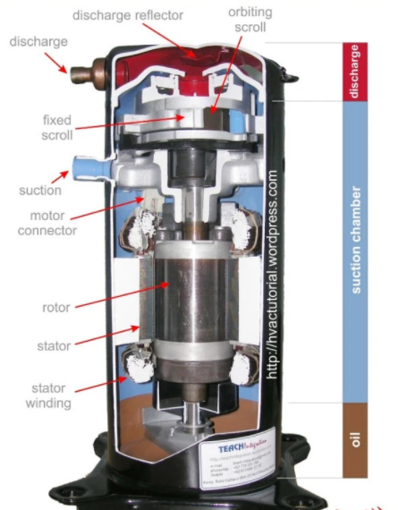
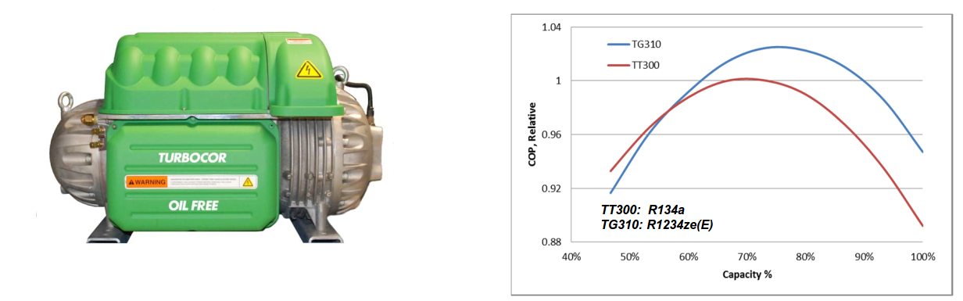
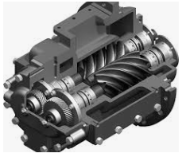
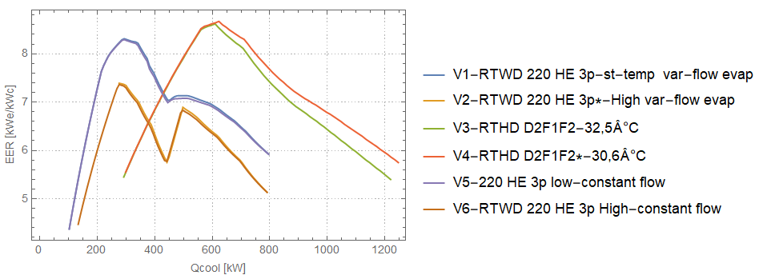
Example:
You have large building with heat load of 6400 kW .
You have available to select from chillers with efficiencies similar
acc patterns visible on graph.
Which and how many chillers would you select
and which control logics would you define
for minimizing energy consumption?
EXAMPLE 1 COMPRESSORS

Slide 20
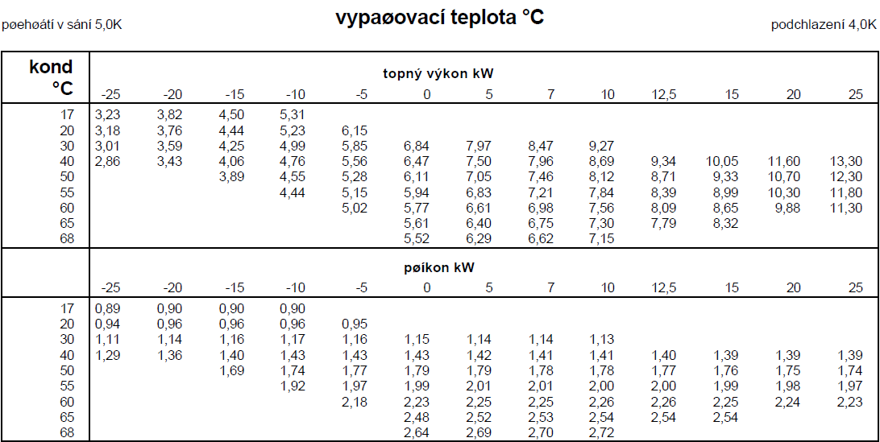
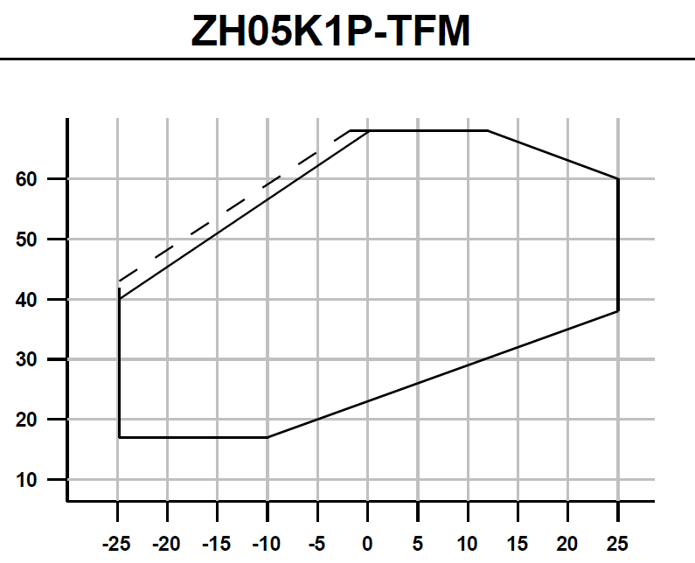
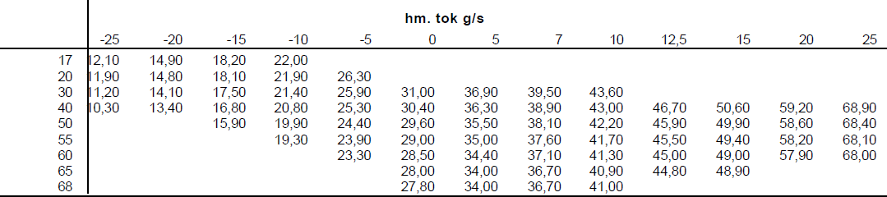
Gas overheating 5°K
Evaporating temperature [°C]
Subcooling 4 °K
Heating capacity [kW]
EXAMPLE 1 COMPRESSORS
Working area
(example of scroll compressor w.a.)
Input power[kW]
Mass flow [g/s]
Compressor Selectors: e.g.
Copeland-Select, Bitzer, Danfoss

Slide 21
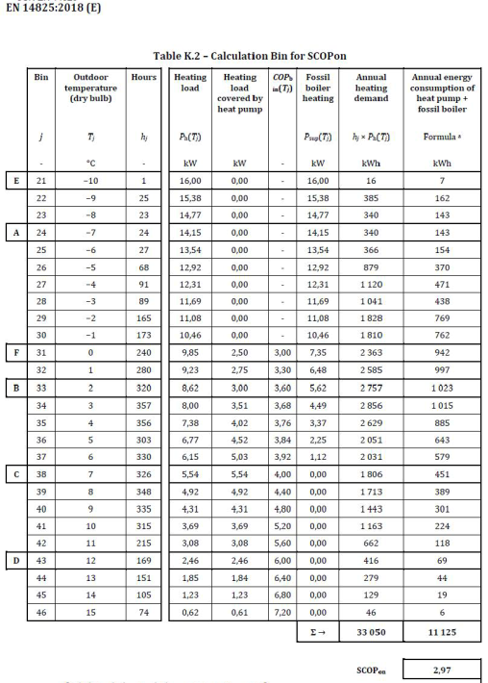
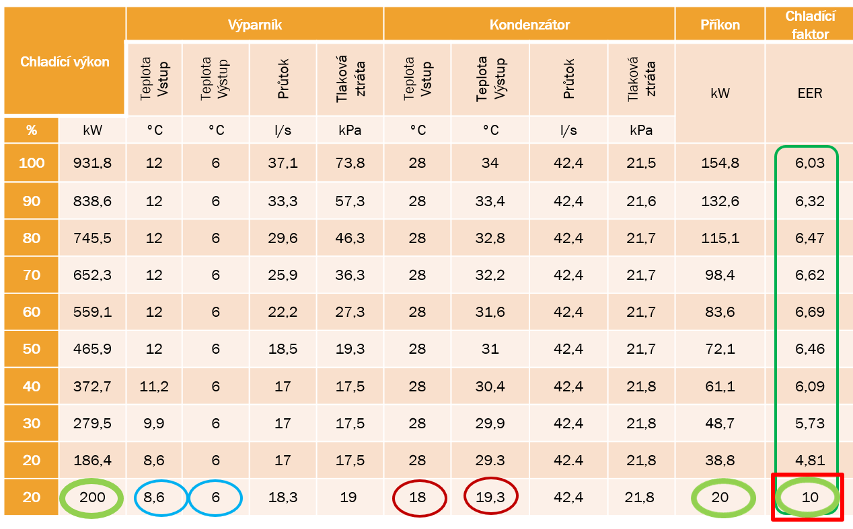
Heat-pumps tabular parameters
evaporator
condenser
Input power
efficiency
Cooling
capacity
EEWT
LEWT
flow
Pressure drop
ECWT
LCWT
flow
Pressure drop
Source: Ing.Matejicek, Ideal operation of cooling Systems, www.ingmatejicek.cz
Source: EN 14825:2018 - Air conditioners, liquid chilling packages and heat pumps, with electrically driven compressors, for space heating and cooling - Testing and rating at part load conditions and calculation of seasonal performance (actually, valid is the 2020 version)

Slide 22
thermophysical properties of Refrigerants
refrigerants
R11
R12
R22
R23
R32
R124
R125
R134A
R143A
R161
R717
R744
R1234yf
R410A
R407C
R507A
R404A
EXAMPLE 1 COMPRESSORS
Isoentropic efficiency (overal efficiency) of compressor
kde je P compressor input power [W]
h_{v} enthalpy on the pressure discharge side of compressor [J.kg⁻¹]
h_{s} enthalpy on the suction side [J.kg⁻¹]
h_{ie} enthalpy after isoentropic compression [J.kg⁻¹]
η_{k} overal effciencz of compressor [-]
η_{k} = f(n,σ,t_{k}, t_{v}, geometrie)
Refrigerant libraries:
Refprop
Coolprop https://github.com/CoolProp/CoolProp
Solkane

Slide 23
EXAMPLE 1 COMPRESSORS
WE MAY HAVE JUST RESULTS OF SUCH COMPUTATIONS (THROUGH PRODUCT DATA FROM MANUFACTURERS)
For describing heating/cooling capacity, input power, COP/EER, may be used analytical form : polynomial expression
Extractable from numerical data by linear regression for finding the constants of regression curves
Or created by manufacturers on their own

Slide 24
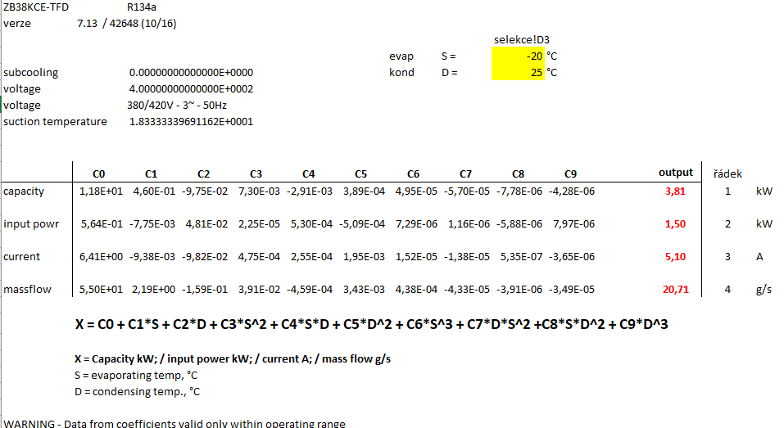
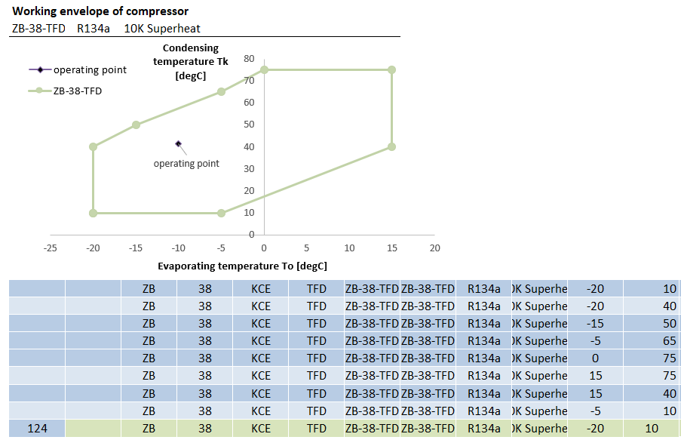
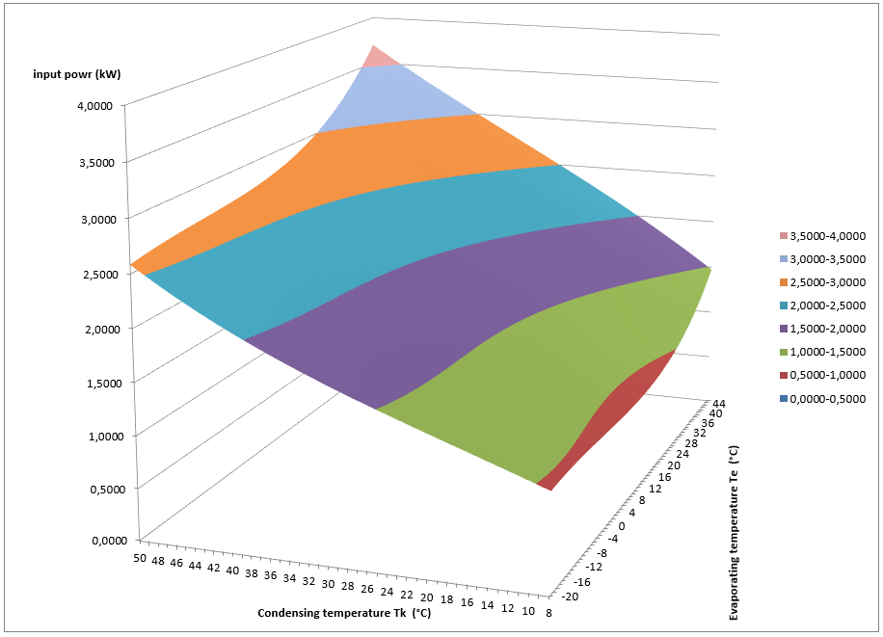
EXAMPLE 1 COMPRESSORS
Source of compressor data: Copeland Select Software, compressor selection software
https://climate.emerson.com/en-gb/tools-resources/copeland-select-software

Slide 25
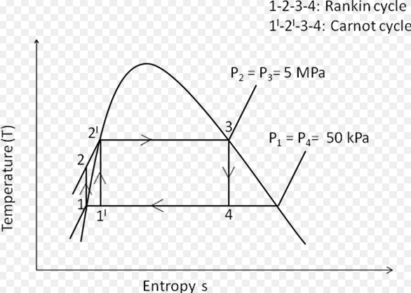
CoolProp
library parameters for refrigerant state description in the rankin/carnot cycle
EXAMPLE 1 COMPRESSORS
constants>:
Outputs | Unit | Název
Q | - | Dryness
T | K | Temperature
P | kPa | Pressure
D | kg/m3 | Density
C0 | kJ/kgK | Specific heat capacity of an ideal gas in an isobaric process
C | kJ/kgK | Specific heat capacity of the isobaric process
O | kJ/kgK | Specific heat capacity of isochoric process
U | kJ/kg | Internal energy (specific)
H | kJ/kg | Enthalpy (specific)
S | kJ/K | Entropy (specific)
A | m/s | velocity
G | kJ/kg | Gibbs energy
V | Pa.s | Dynamic viscosity
L | kW/mK | Thermal conductivity
I | N/m | Surface tension
Výstupy | Jednotka | Název
Tcrit | K | Critical temperature
pcrit | Pa | Critical pressure
rhocrit | kg/m³ | Critical density
molemass | kg/kmol | Molecular weight
Ttriple | K | Triple point temperature
ptriple | Pa | Triple point pressure
GWP100 | - | Global Warming Potentian in 100 yrs
ODP | - | Ozone Depletion Potential

Slide 26




Slide 27



3D shapes as descriptors of fluid properties
Source: some ASHRAE fundamentals book (forgot to write down)

Slide 28

EXAMPLE 1 COMPRESSORS
Electric heat pumps efficiencies described in numerical and analytical form
COP profile of electric heat-pump (Remko Quantum)
LCWT – leaving condenser water temperature
COP [ kWh / kWe ]
External dry bulb temperature °C

Slide 29

EXAMPLE 1 COMPRESSORS
Gas heat pumps efficiencies described in numerical and analytical form
LCWT – leaving condenser water temperature
COP profile of gas heat-pump (Yanmar)
COP [ kWh / kWe ]
External dry bulb temperature °C

Slide 30




HEAT-PUMPS
example of complicated product parameters:
compressor efficiency

Slide 31

Operation properties of products with Rankine-carnot cycle circuits
Electrict heat pumps and chillers

Slide 32
What properties do they need to have common ?
EXAMPLE 2 OPERATION PARAMS.
They work with the same medium properties
- temperatures
- fluid movements in ducts/pipes
-direction
-volume flow
-friction (pressure drop)
-pressure
Example:

Slide 33


Example : FCU unit
Basic (static) parameters: weight, name, connection diameters, dimensions of FCU , Dimensions of service space…
But operational parameters : (in DESIGN and OPERATION afterwards)
EXAMPLE 2 OPERATION PARAMS.
water
water
water
water
Air parameters
Air parameters
Fan speed
Cool cap tot
Cool cap sens
Heat cap
Volume flow m3/h
Supply pressure Pa

Slide 34






Technical description
Application:
Heating and cooling systems.
Functions:
Control Balancing Pre-setting Measuring Shut-off
(for isolation during system maintenance)
Dimensions:
DN 15-25
Pressure class:
PN 16
Temperature:
Max. working temperature: 120°C Min. working temperature: -20°C
Media:
Water or neutral fluids, water-glycol mixtures (0-57%).
Source:
manual TBV-CM_EN_MAIN

Slide 35




Source:
manual TBV-CM_EN_MAIN

Slide 36


Source:
manual TBV-CM_EN_MAIN

Slide 37



Accoustic tabular data
Accustic power
Product parameter
Accoustic power (source)
Own noise of attenuator
Computation result
Final acc.power including attenuation
Computation result
Acc.power
Acc.power
Acc.power
Acc.power
Difference with / w/o attenuator
Noise source
Attenuator attenuation
Duct attenuation
Attenuated noise
Product parameter
Duct attenuation
Overall atenuation
Overall attenuation
Computation result
Acc.pressure
Further assessment
Source: excel selector Greif attenuator products, AHU unit parameters, Atrea manufacturer
A-veightet values, NR, NC

Slide 38





Accoustic tabular data
Assessment near noice receiver
Accustic pressure and other criteria
Source: Fundamentals of HVAC accoustic, Trane, TRG-TRC007-EN-01

Slide 39


EN 13779 [4-1997] Ventilation for non-residential buildings –
performance requirements for ventilation and room conditioning systems
EXAMPLE 2 OPERATION PARAMS.
End of table

Slide 40


Source: EN 16798-[3:2020] Energy performance of buildings - Ventilation for
buildings - Part 3: For non-residential buildings - Performance requirements for
ventilation and room-conditioning systems (Modules M5-1, M5-4)
and also non-valid EN 13779 [4-1997] (non-valid)
EXAMPLE 2 OPERATION PARAMS.
According the EN 16798 , there are many air categories dependent on its function/purpose and placement of air in ventilation system and building
From: Table2-specification of type of air, EN 13779 [4-1997]
Resp. Table 6. EN 16798-[3:2020 ]

Slide 41


Examples collection ? container ? Well-Known-Text WKT ?
How to define tabular product data ?
Maybe .. ?

Slide 42


Geosparql Spatial Objects GeoSPARQL spatial relations
How to define product data defined in curves
And 3d shapes ?
geosparql:asWKT"MULTIPOLYGON ((( …
polygon(( …
Maybe .. ?
Source: presentation Semantic GIS – GeoSPARQL,Michal Med, FEL – CTU Prague

Slide 43
CAUSALISTIC PROPERTIES
CAUSALISTIC PROPERTIES
IF some individuals reach some state/situation
THEN … do something … (e.g. align particular constant property to ind., name… define it into particular class)
ELSEIF ….
ELSE … do nothing…

Slide 44


Table 1 fire resistance of protected ventilation ducts and fire dampers
degree of fire safety of the fire zone
CAUSALISTIC PROPERTIES
fire resistance of ventilation equipment [min]
Would be possible to validate design according the fire code ?
=>Resulted required resistence is : 30 minutes
IF there would be two fire zones with adjanced area:
align higher fire resistance parameter to all air air systems elements passing through such area.
The basic scale of fire resistance is : 15, 30, 45, 60, 90, 120 a 180 minutes.
The classification of the product according to ČSN EN 13 501 is based on a test.
Tab. 1 - Stupně hořlavosti a třídy reakce na oheň
In the case of the European classification for reaction to fire classes A2, B, C and D,
an additional classification is added which characterizes the product in terms of:
falling or dripping of burning parts or droplets, (designation: d0, d1, d2),
smoke generation (designation: s1, s2, s3).
Degree of flammability 73 0823 | Fire reaction class ČSN EN 13 501-1
A | A1
B | A2
C1 | B
C2 | C or D
C3 | E or F

Slide 45



Would be possible to validate design according the fire code ?
CAUSALISTIC PROPERTIES
IF there would be two fire zones with adjanced area:
align higher fire resistance parameter to all air air systems elements passing through such area
- either define protection of duct
- or define requirement of fire damper
Fire zone
Fire damper
Air inlet/outlet
Source: ČSN 73 0872_[2-1996] fire safety of buildings (czech code)

Slide 46


CAUSALISTIC PROPERTIES
Align particular constant to envelope element according pair of spacetypes aligned and take in account also heat-flow directions
Source: EN 73 0540-2 [2011] computation UN,20 čl. 5.2.1. b)

Slide 47


CAUSALISTIC PROPERTIES
Would be possible to align particular property value according spatial situation ?
IF there would be some shading element near the glazed opening:
align shading data computed according space position to the glazed opening.
Source:EN ISO 52016-1
Energy performance of buildings - Energy needs for heating and cooling, internal temperatures and sensible and latent heat loads - Part 1: Calculation procedures

Slide 48





Source:EN 16798-[3:2020] Energy performance of buildings - Ventilation for buildings - Part 3: For non-residential buildings - Performance requirements for ventilation and room-conditioning systems (Modules M5-1, M5-4)
EXAMPLE 3 SPATIAL
Could the occupied zone be „SPARQL-ed“ ?
Usable for building daylight simulation processing :
Visual comfort analysis BREEAM,
Spatial Daylight Autonomy (sDA) etc.

Slide 49







Pressure drop in AHU and its internal components -> principles
EXAMPLE 2 OPERATION PARAMS.
Figure: pressure drop in AHU, Source: CCVA Air handling units, Trane, CCVA-PRC-1003-EN

Slide 50


Source: EN 16798-[3:2020] Energy performance of buildings - Ventilation for
buildings - Part 3: For non-residential buildings - Performance requirements for
ventilation and room-conditioning systems (Modules M5-1, M5-4)
and also non-valid EN 13779 [4-1997] (non-valid)

Slide 51


Source: EN 16798-[3:2020] Energy performance of buildings - Ventilation for
buildings - Part 3: For non-residential buildings - Performance requirements for
ventilation and room-conditioning systems (Modules M5-1, M5-4)
and also non-valid EN 13779 [4-1997] (non-valid)

Slide 52


Fire protection layout [revision03]
Fire protection layout [revision04]

Slide 53

Pressure properties within builiding over-pressure / under-pressure
estimations
Source: Trane Engineers Newsletter vol 31-2 (ADM-APN003-EN)

Slide 54

Pressure properties within builiding over-pressure / under-pressure
estimations
Source: Trane Engineers Newsletter vol 31-2 (ADM-APN003-EN)

Slide 55

Pressure properties within builiding over-pressure / under-pressure
estimations
Source: Trane Engineers Newsletter vol 31-2 (ADM-APN003-EN)

Slide 56
Pressure properties within builiding FIRE SAFETY
(WERY IMPORTANT)
EN 12101-6 Smoke and heat control systems - Part 6: Specification for pressure differential systems – Kits
… maybe next time

